Slide 1
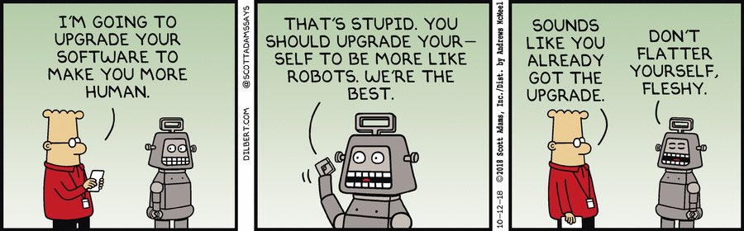
Forward Kinematics
Design Problem 1

Slide 2
Agenda
Problem Background
Learning Objectives
Live Coding!

Slide 3
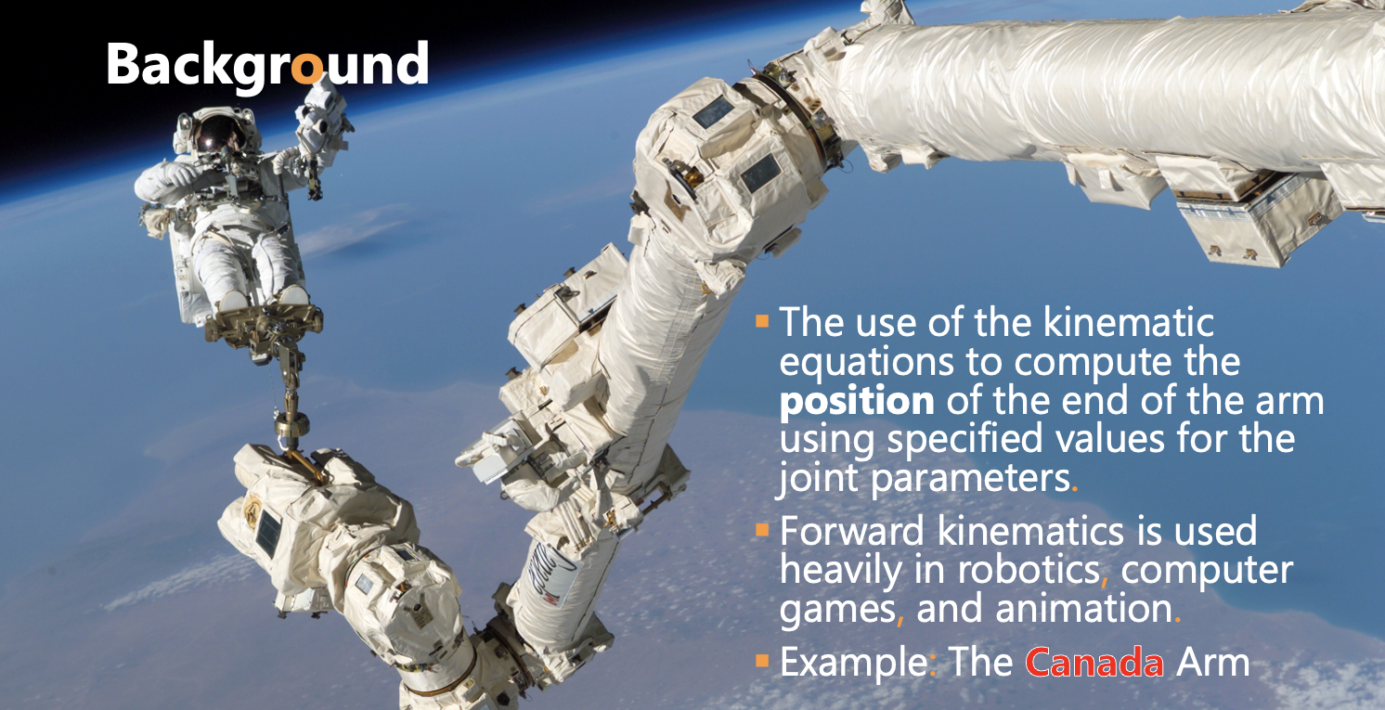

Slide 4
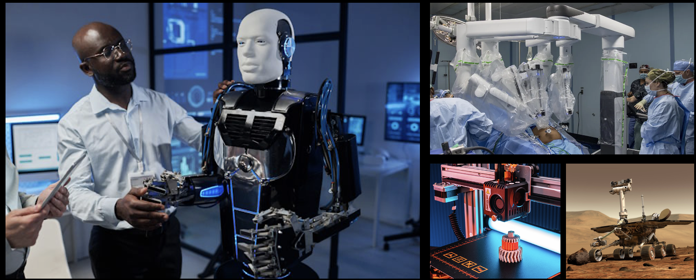
Other Cool Examples:
Humanoid and Industrial Robots, Animations and Gaming, 3D printing, …

Slide 5
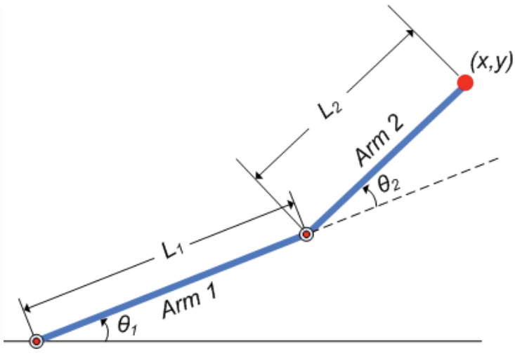
Background
Goal: Create a program that finds the x- and y- position of the effector arm (i.e. the end of Arm #2).
Will rely on trigonometry to find the positions.

Slide 6
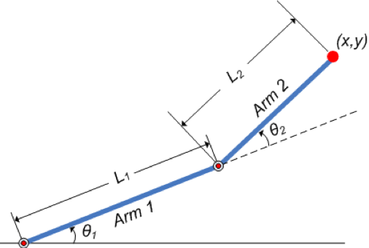
Design Problem 1: Forward Kinematics
Where is this point?
my_function(Length1, Angle1, Length2, Angle2)
Given
Length1, Length2,
Angle1, Angle2

Slide 7
Learning Objectives
Practice with user input.
Learn to define and use custom functions.
Practice with built-in libraries.

Slide 8
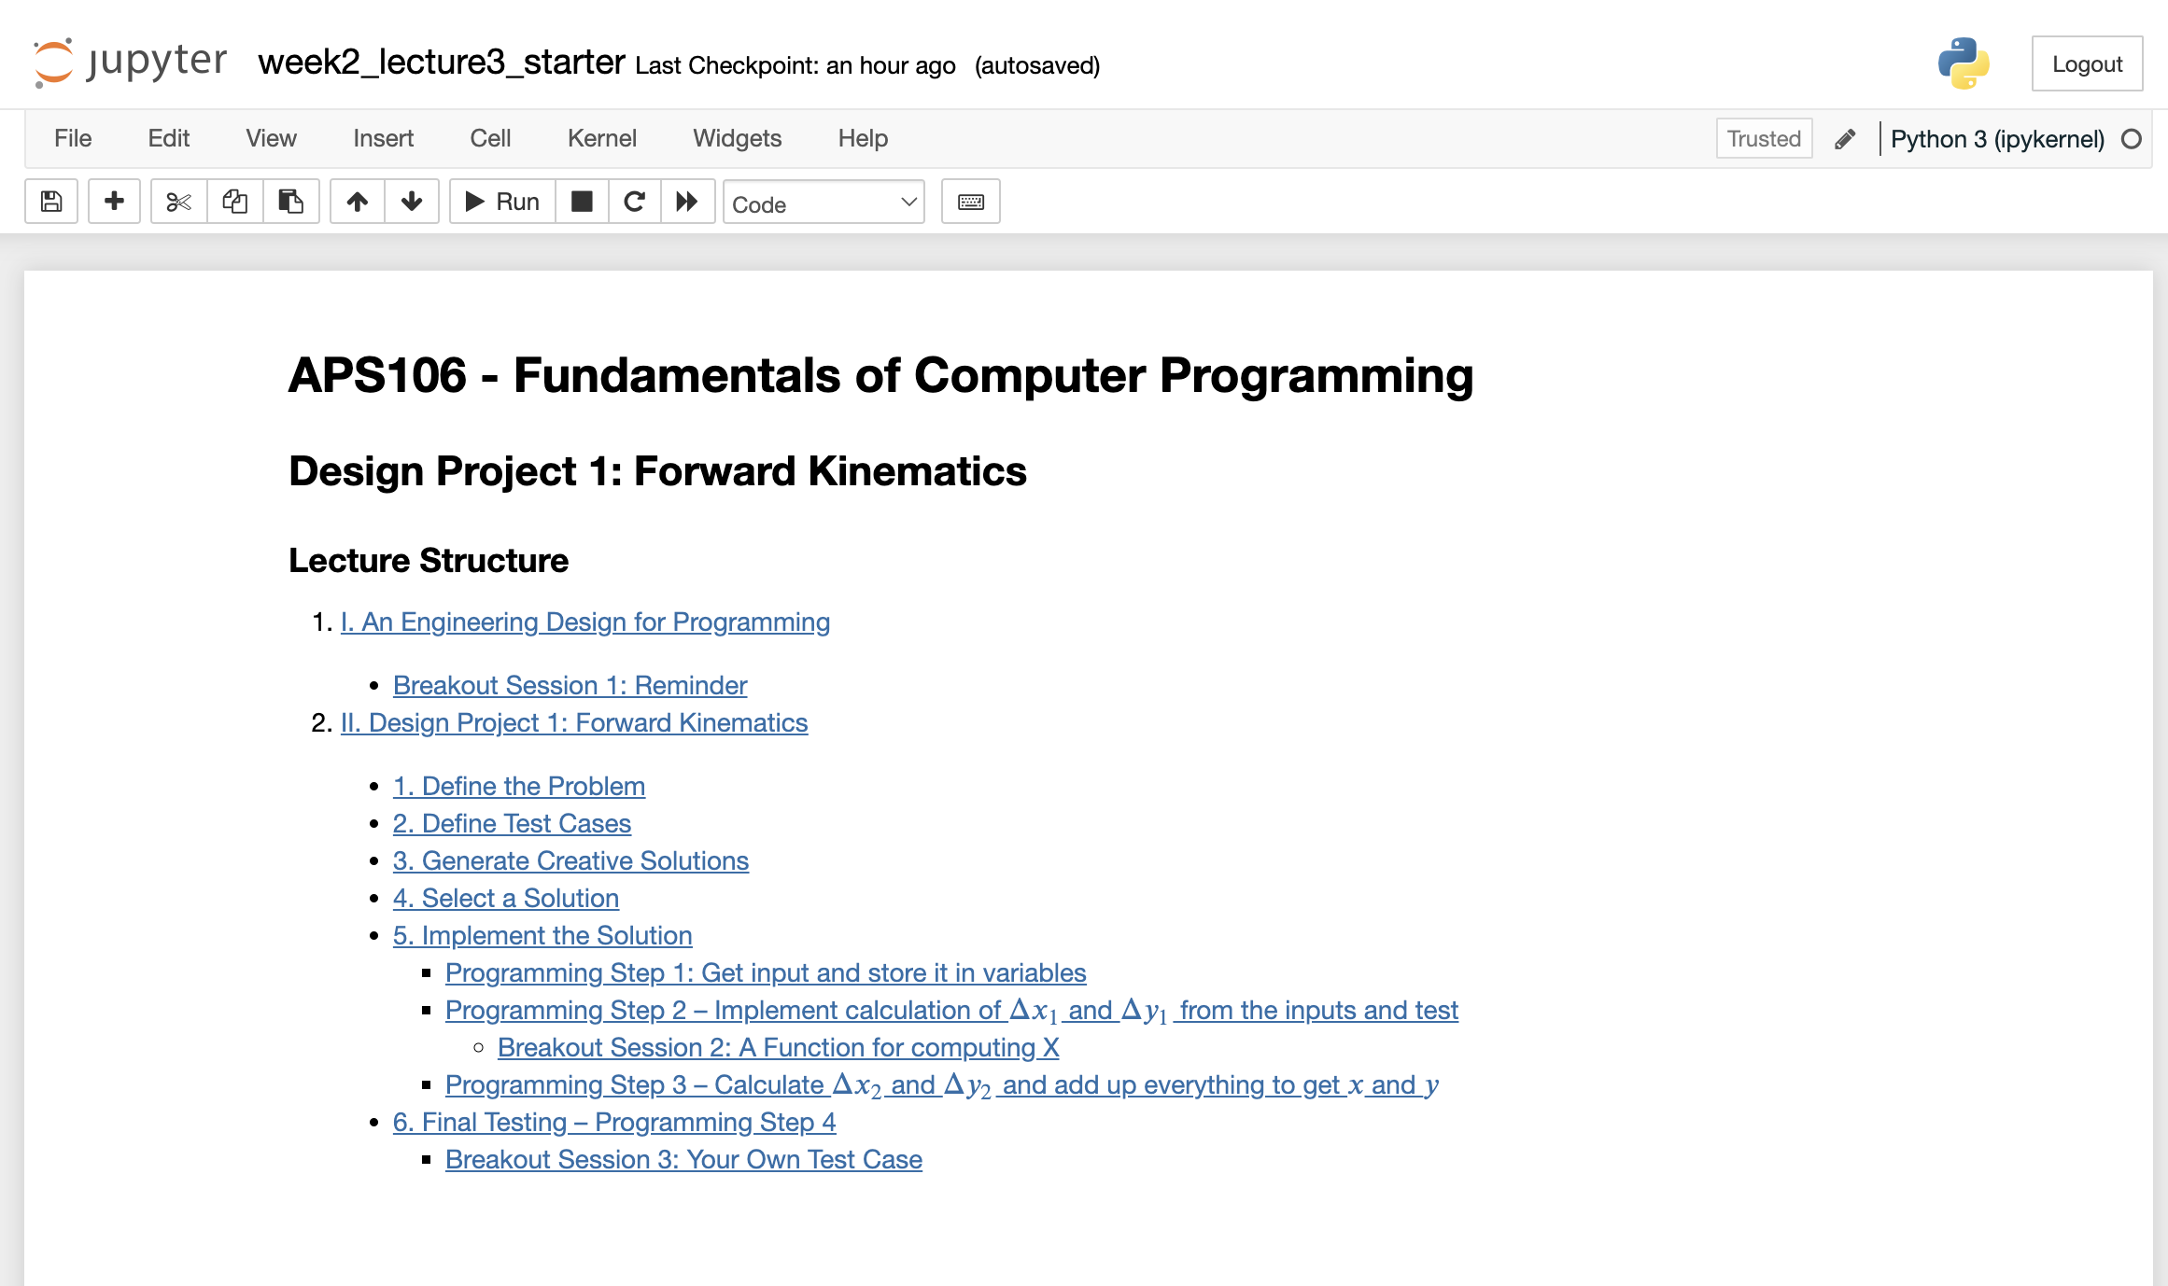
Forward Kinematics
Design Problem 1
Let’s review the notebook now!

